Slide 1
Billy’S escape

Slide 2

Advantages:
Text-base games
disAdvantages:
Low requirements.
Easy to take.
Easy to put down.
Low level of engagement
with the player.
Target audience:
People playing, because of nostalgia.

Slide 3

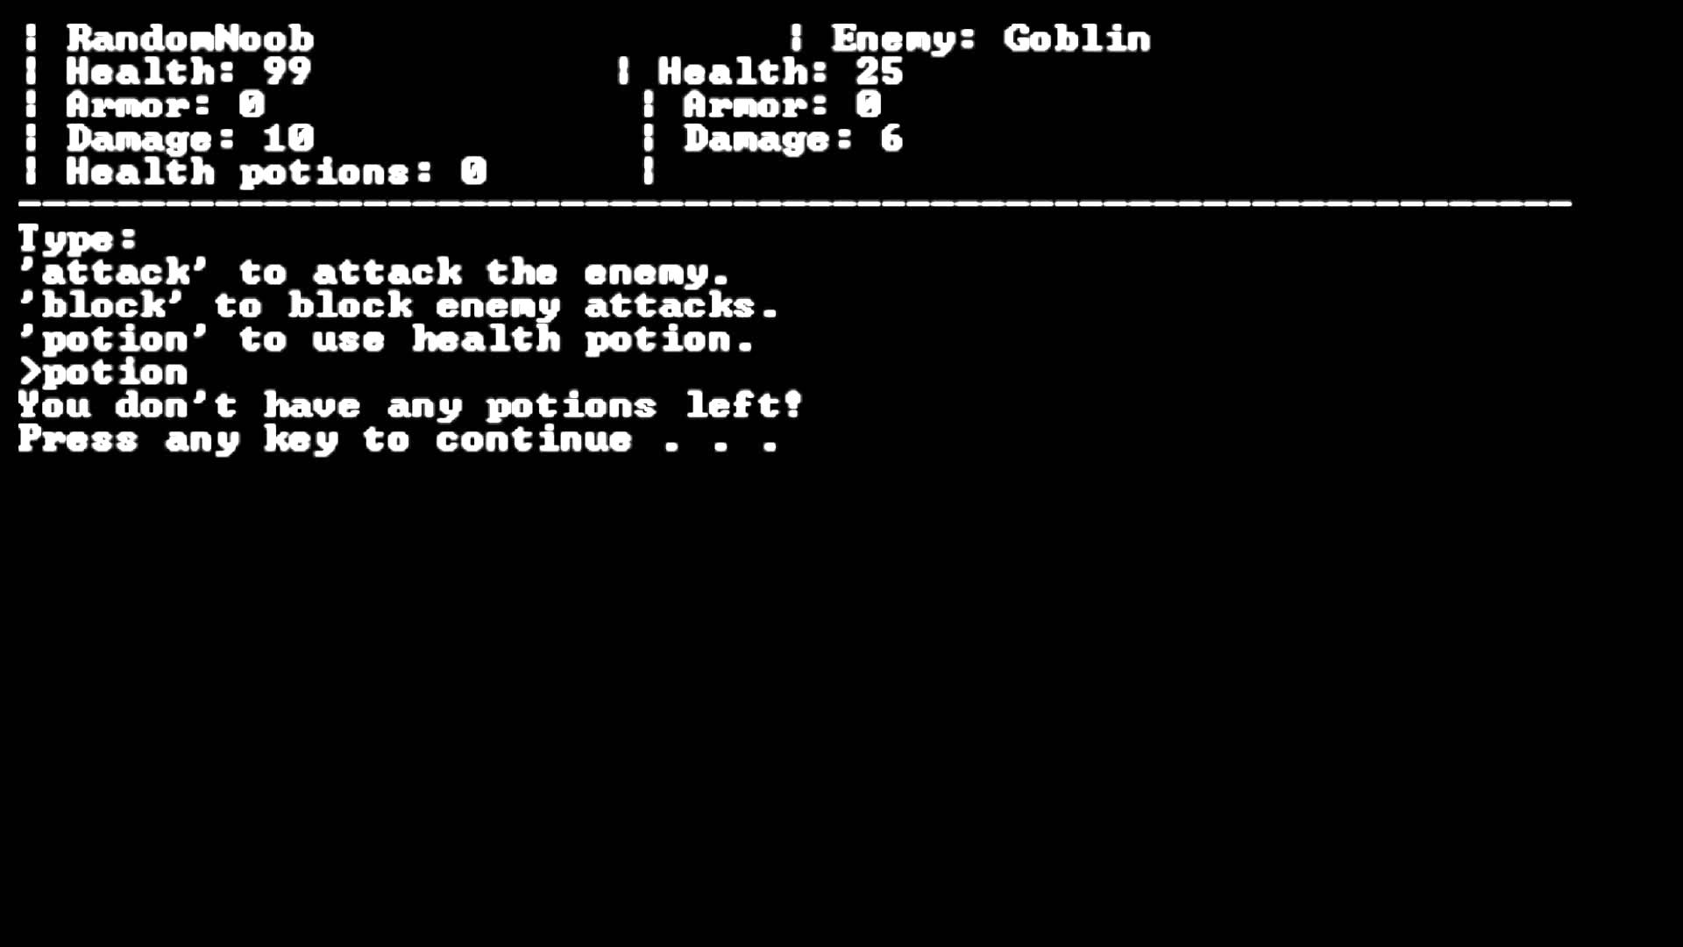
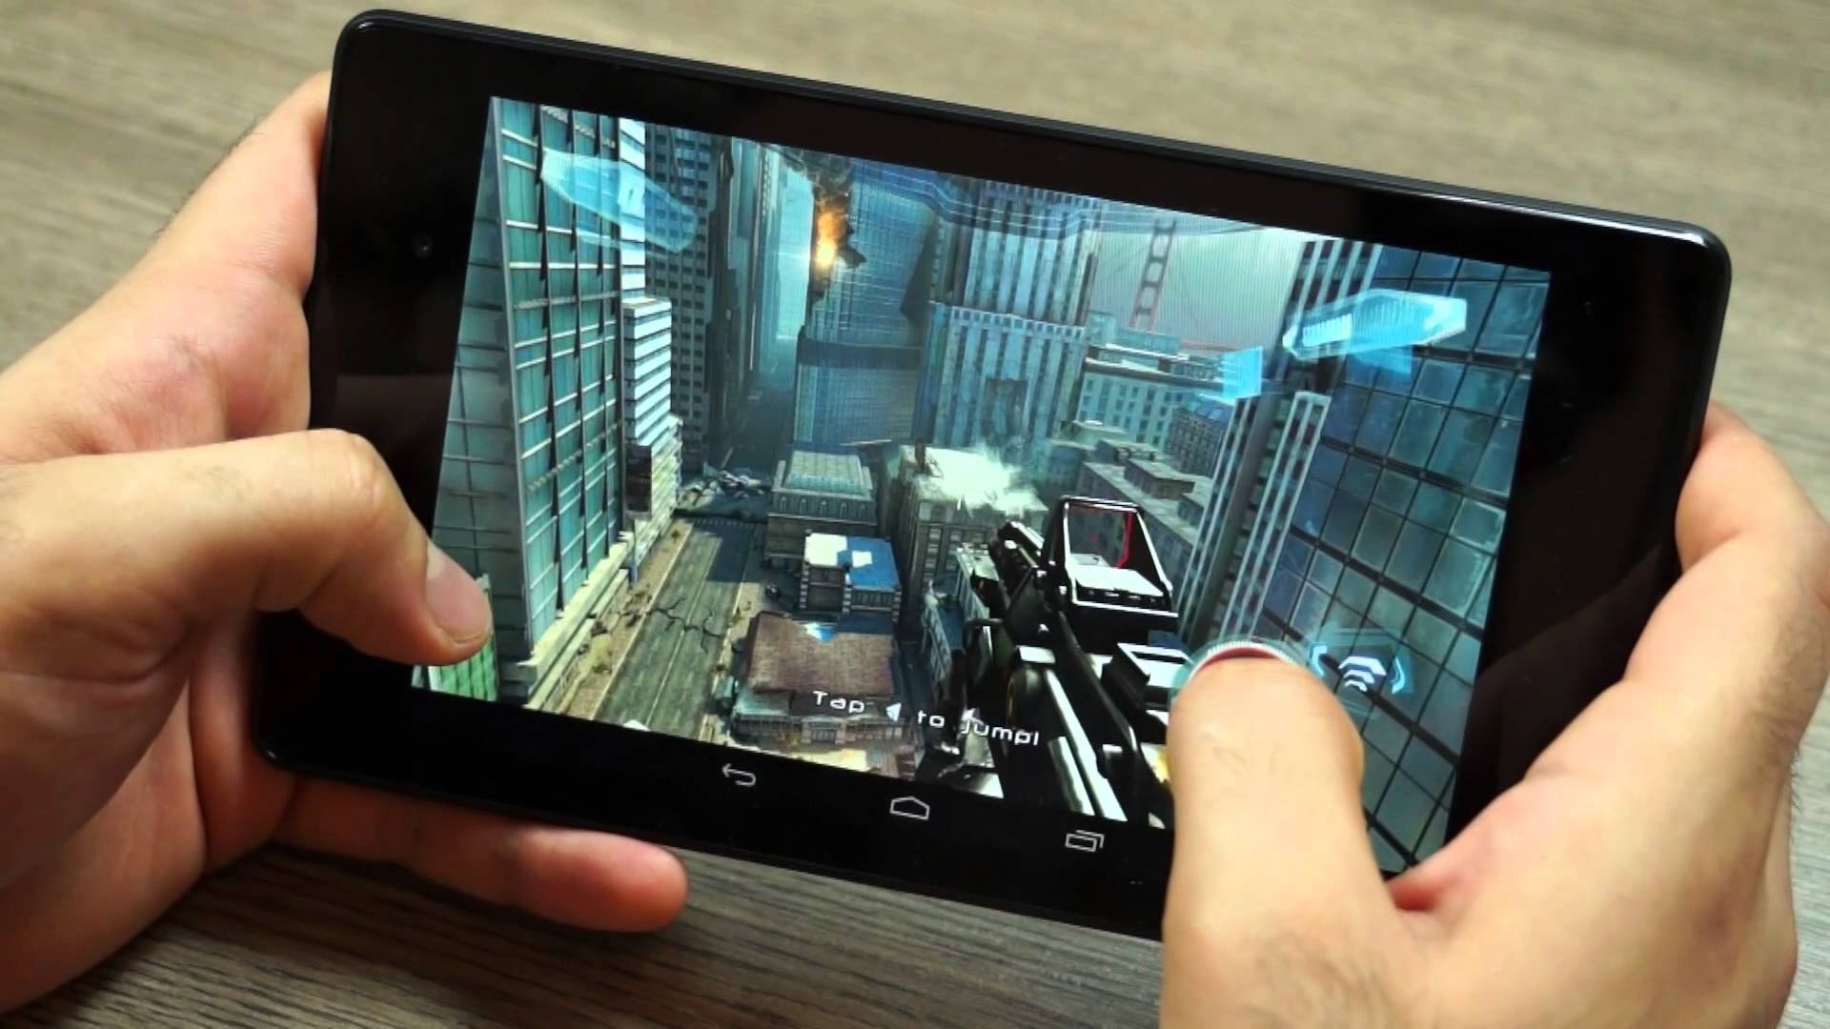
New technologies:
Text-based games:

Slide 4
Main Features
The game environment is relatable to the target group.
There is sound throughout the entirety of the game which changes in some rooms like the basement and bathroom
Mini game to get a key component to winning the game
We have incorporated a timer function which is used in multiple places in the program
Time limit for the whole game
Time limit during mini game

Slide 5
Billy’S escape :
Billy’s escape is a text based adventure game
Billy is a teenager who wants to escape the house for a legendary house party without being caught from his parents
SOUND:
Adds depth to the game.

Slide 6
DYNAMIC WORLD:
Every time Billy enters a new room the description changes a bit.
Adds diversity and depth to the game.

Slide 7
GAME MAP
Bathroom
Billy’s
Bedroom
Window
Closet
Parent’s Bedroom
Hallway
Sharon’s
Bedroom
Lounge:
Mum and Dad!!
Hallway
PARTYY
Kitchen
Basement

Slide 8
items
Backpack: To store coke and vodka
Rope: To climb out of his bedroom window
Lighter & Deodorant: To clear spider webs
Flashlight: For items which are beyond Billy’s vision
Glasses: To improve Billy’s vision
Watch: To check how much longer Billy has to escape

Slide 9
Game Demonstration

Slide 10
Thank you for listening
We will now welcome any questions
Billy’s escape was developed by:
Sam Davis
Georgios Diamantopoulos
Adam Parrington
Reema Abaoud
Todor Pertov
Laura Edwards
Sebastian Squire
Jacob Winkworth

